Slide 1
Xiaomi Group Introduction

Slide 2
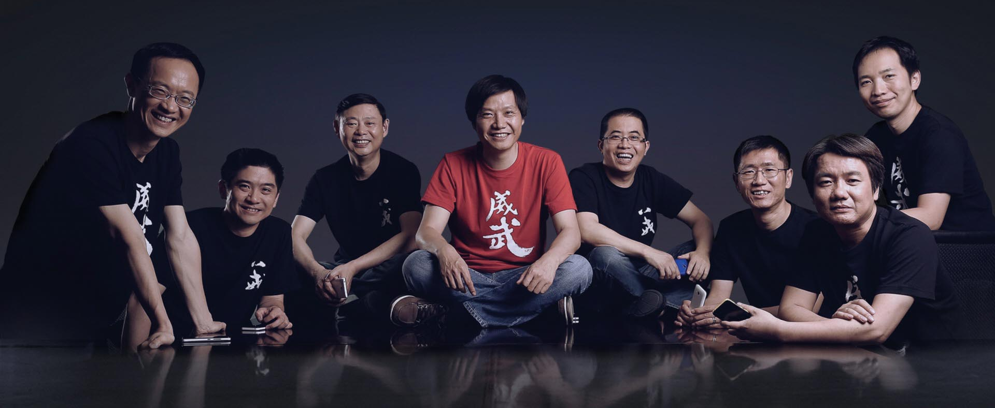
Founded on April 6th, 2010

Slide 3
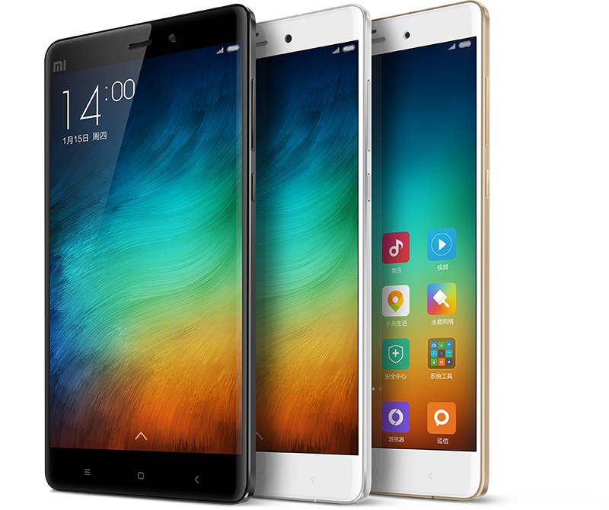
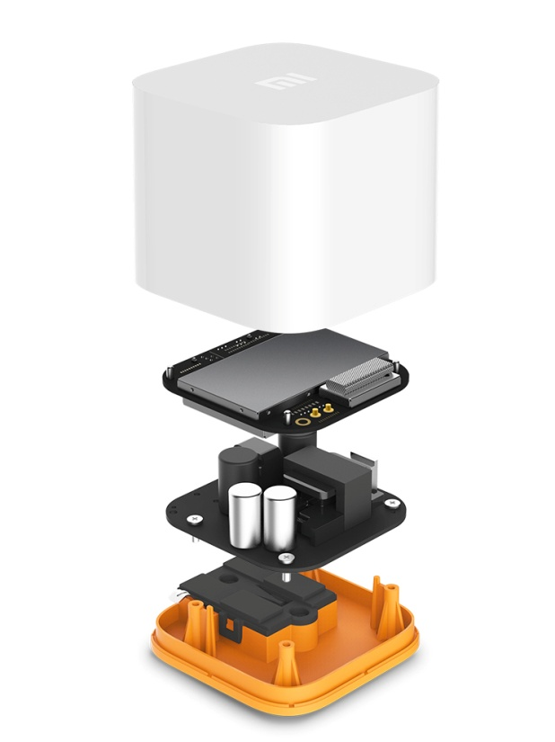
Xiaomi Business Model – 1. High Quality Products

Slide 4
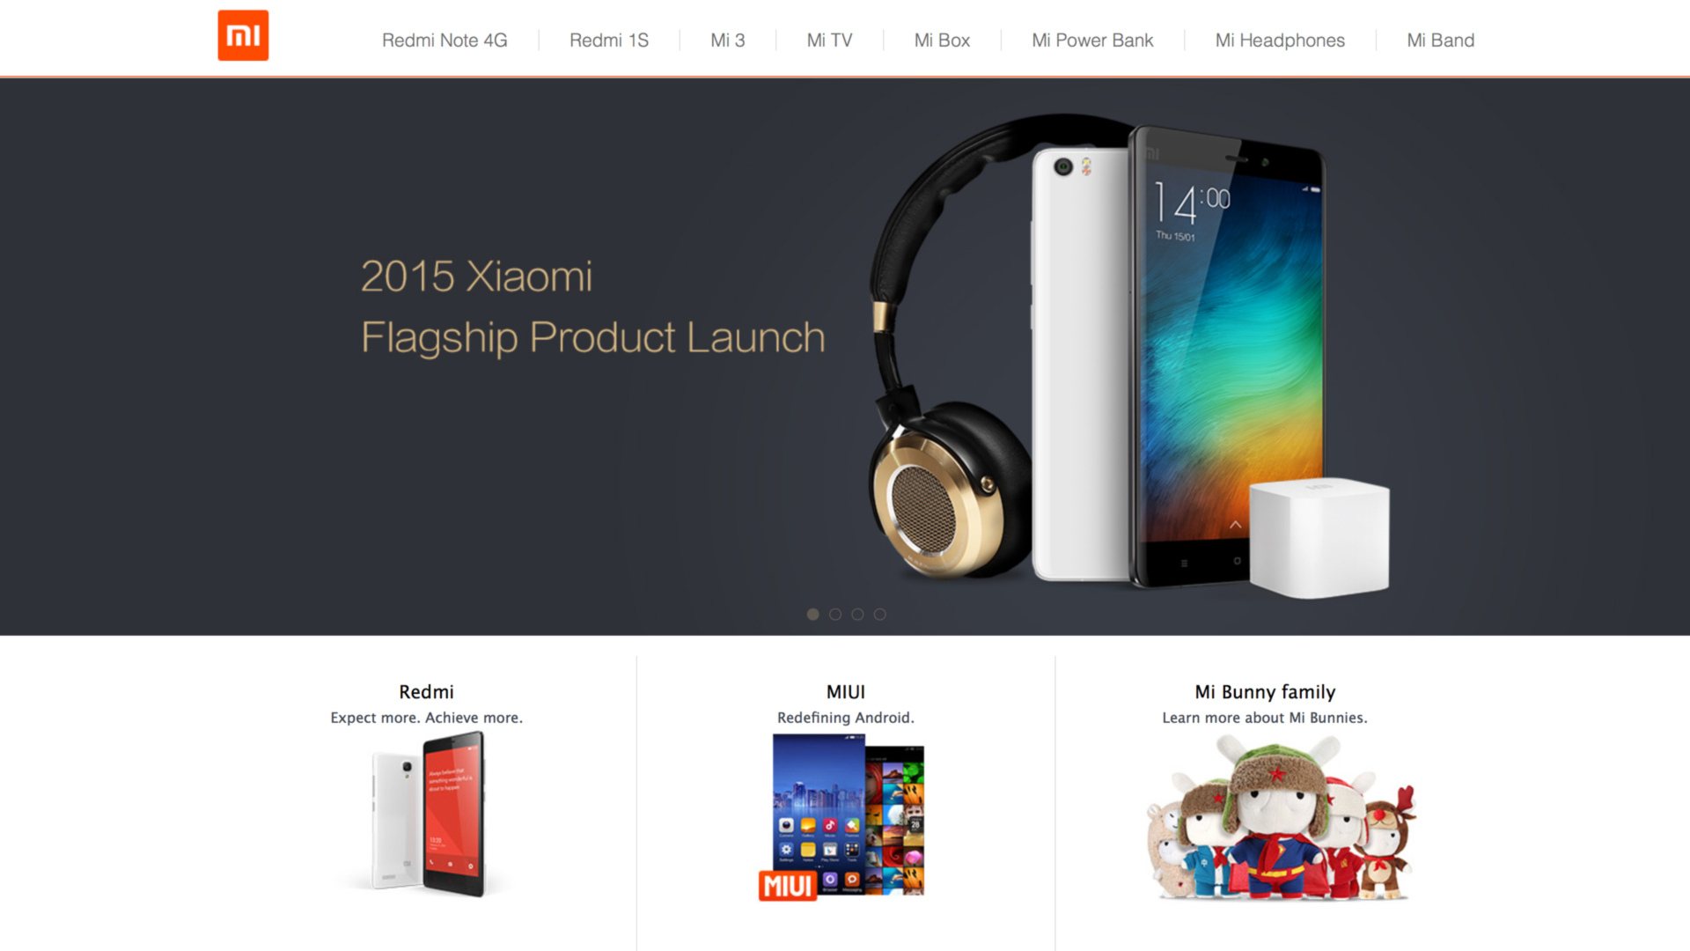
Xiaomi Business Model – 2. Selling products at cost on MI.COM

Slide 5
Xiaomi Business Model – 3. Word of Mouth Marketing and Social Media
A photo of two heavy men sitting on a Xiaomi packaging box was widely spread through China Social Medias.
This marketing activity reflects the quality of Xiaomi packaging and products.

Slide 6
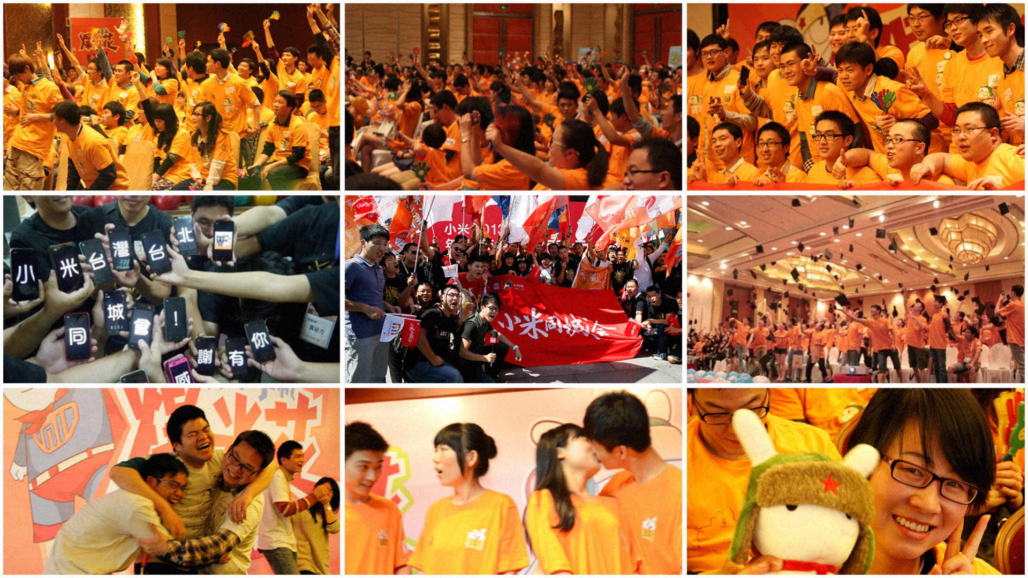
Xiaomi Business Model – 4. Mi Fans

Slide 7
74
Billion
RMB revenue for 2014 posing a growth of 134%
61 million Mobile phones sold in 2014

Slide 8
Our innovation is widely recognized by world renowned media

Slide 9
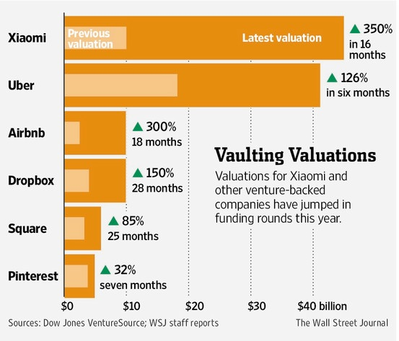
Valued at 46 billion USD

Slide 10
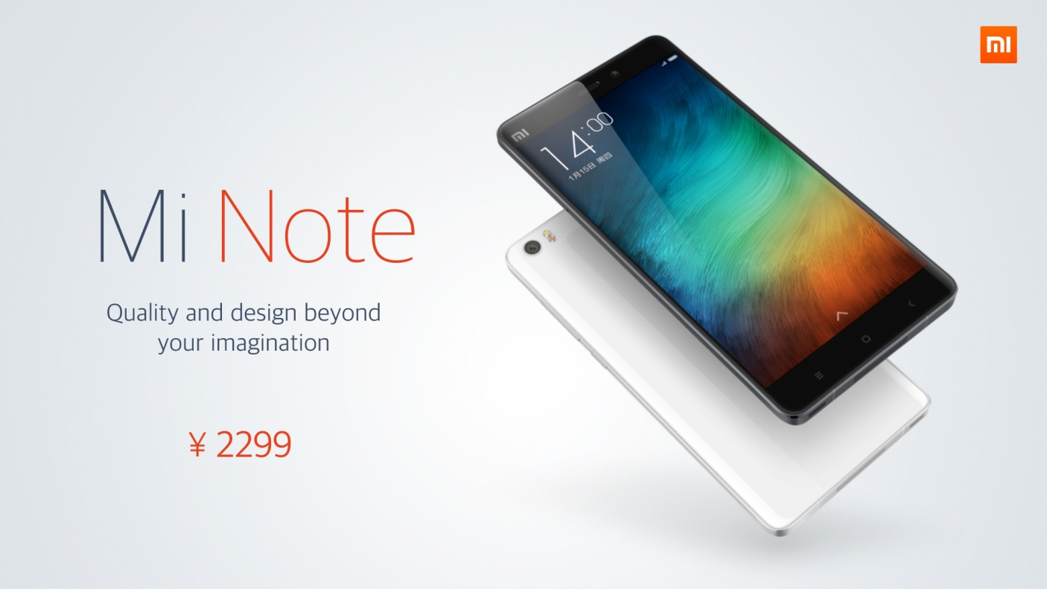
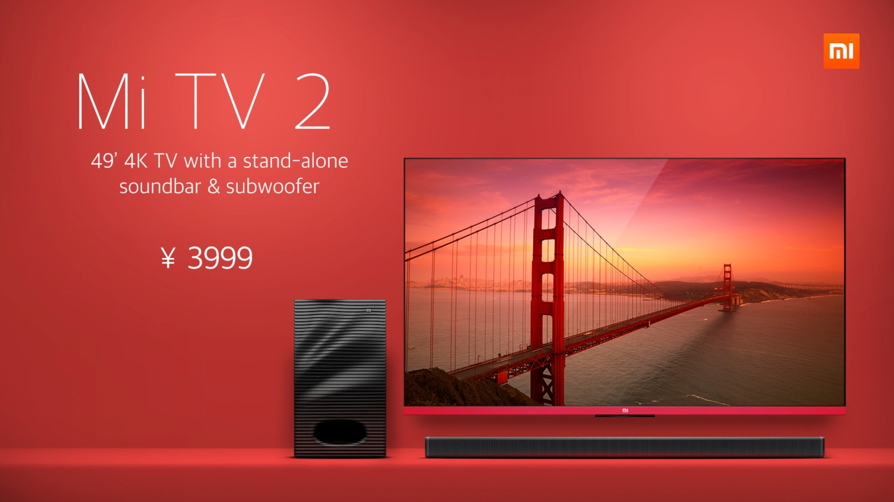
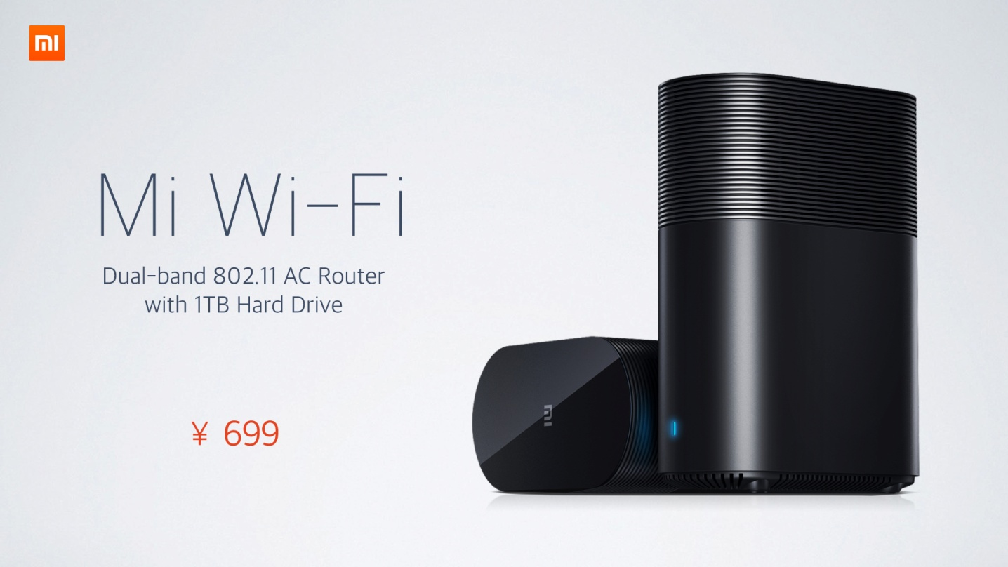
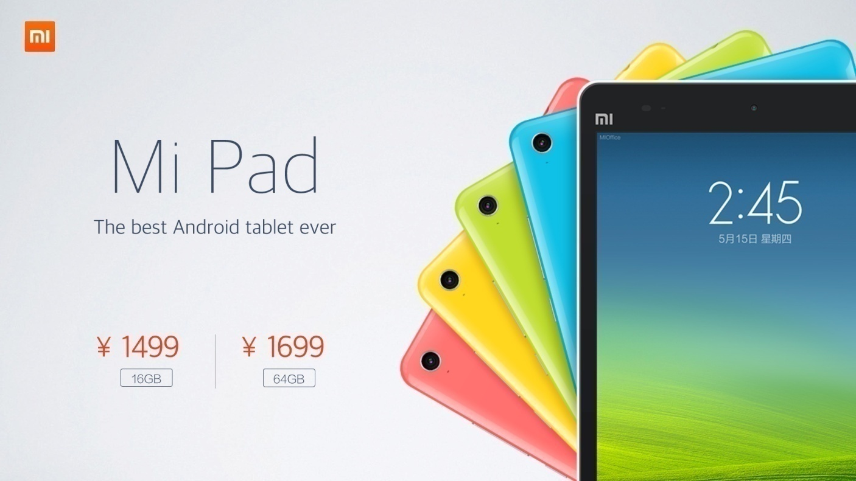
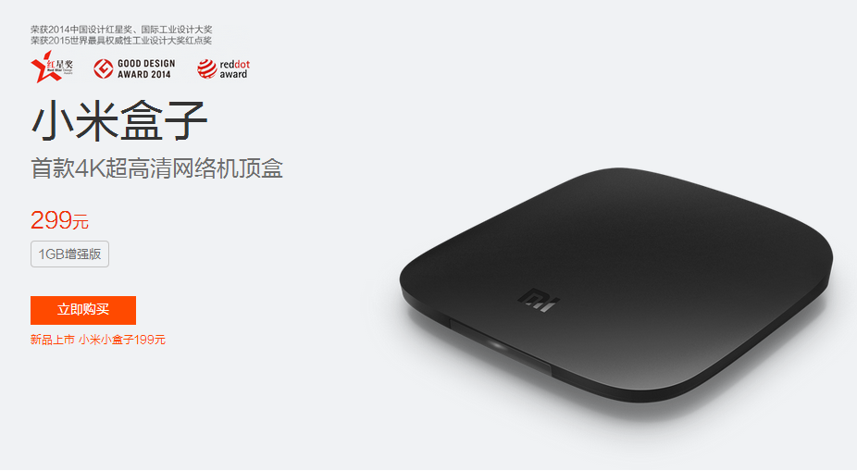
Xiaomi Core Products
Xiaomi Phone and Pad
Xiaomi TV and OTT box
Xiaomi Wifi Router

Slide 11
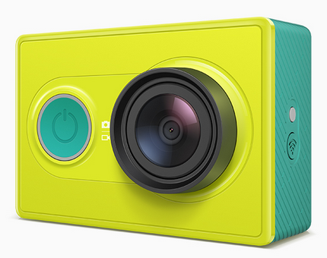
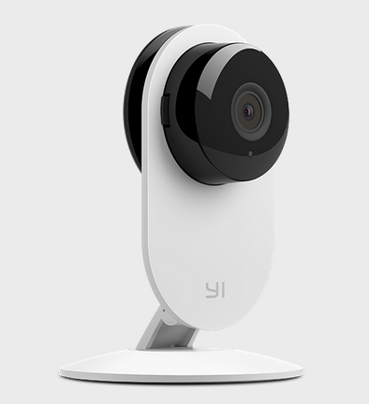
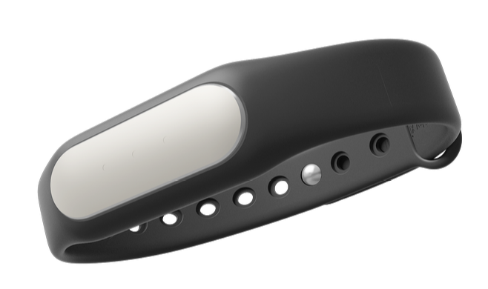
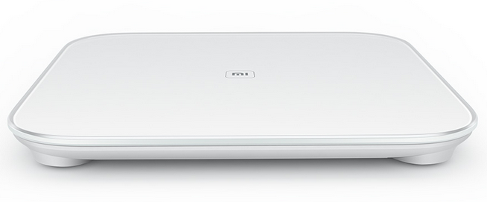
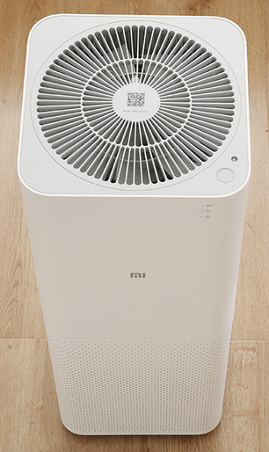
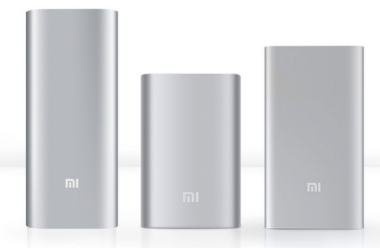
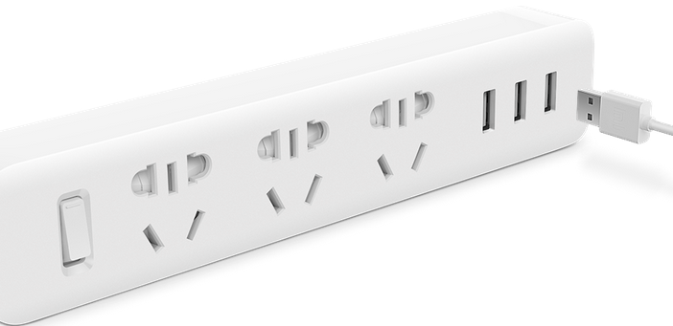
Products from Xiaomi Invested startup companies
Action Camera
Smart Cam
MI Band
Bathroom Scale
Air Purifier
Power Bank
Power Strip

Slide 12
Xiaomi, way to go.

